Slide 1
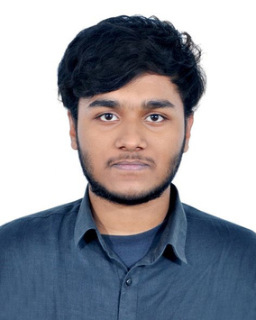




Nadim Rahman Nion
ABOUT ME
Student
I am a dedicated and hardworking person with a sharp intellect and a passion for excellence. I am known for my relentless work ethic and ability to deliver outstanding results in challenging environments. Adept at analyzing complex problems, devising innovative solutions, and implementing effective strategies. Possess strong interpersonal skills, enabling seamless collaboration with diverse teams and stakeholders. Eager to leverage my intelligence and work ethic to contribute meaningfully to ambitious projects and initiatives.
CONTACT ME
01793519323
nionrahman@gmail.com
www.noweb.com
Uttara#13, Uttara, Dhaka-1230, Bangladesh
EDUCATION
WOEK EXPERIENCE
Research Assistant
2023
Independent University, Bangladesh
CIS-101 Project
BBA, Manangement
Current
Uttara High School and College
Higher Secondary School Certificate
2021
National Ideal School
Secondary School Certificate
2019
SKILLS
REFERENCES
Project Management
Razib Hayat Khan, Ph.D.
Strategic Thinking
Assistant Professor
Leadership
Email :
rkhan@gmail.com
Communication
Networking

